Slide 1
Healthy Housing for Seniors
Green & Healthy Homes Initiative – 2021
August 2021
Alexia Jones

Slide 2
HEALTHY HOMES
A healthy home is one that is marked not only by the absence of health and safety threats (lead, indoor allergens, radon, carbon monoxide) in the built environment, but also one that nourishes physical, mental, social and environmental well-being.
Green & Healthy Homes Initiative
With the elderly a fast-growing demographic in the U.S., senior housing issues are taking center stage. The rising cost of living, limited options, chronic health problems and inaccessibility caused by decreased mobility are just some of the housing problems facing the elderly population. As a result, low- and modest-income seniors are having trouble finding safe housing they can afford but that can still meet their changing physical needs.
Elderly Housing Problems – Amber Keefer

Slide 3
HEALTHY HOMES
Many homes have unhealthy conditions:
• 1 in 16 have high radon levels
• 1 in 10 have water leaks
• 1 in 6 have structural problems
• 1 in 4 have lead-based paint
• 1 in 4 do not have a working smoke alarm
An unhealthy home is linked to poor health

Slide 4
THE COST OF HEALTHY HOMES
30M families live in unhealthy and energy inefficient homes
$50.9B+ already spent on lead poisoning
Low income families spend 14-20% of monthly income spent on utilities
VS.
3.5% in all other homes
14.4M missed days of school each year
$51B+ already spent on asthma
14.2M missed days of work each year
$19B+ already spent on slip & fall injuries

Slide 5
SIGNS OF UNHEALTHY HOUSING
Unsanitary living conditions
foul odors, animal or insect infestations, piles of trash
Unsafe living conditions
inadequate plumbing, heating/air, ventilation, home in disrepair
Lack of food in the residence
Inadequate or unclean clothing
soiled, improper dress for weather/conditions
Lack of needed medical aids
hearing aids, glasses, dentures
Unpaid bills
Notes:
So, lets mentally visualize unhealthy housing for seniors

Slide 6
CHW - OVERVIEW
CHW’s play an important role in the public health care team for seniors on the education of addressing home safety hazards & environmental control
You are not required to be total experts in health & safety hazards
BUT if you can identify what MAY be the problem and what MAY be the cause, that is very helpful for the client
CHWs provide education & services that:
improve access to care
increase knowledge
improve health outcomes
prevent disease
*Tailored to the needs of the community*

Slide 7
ENVIRONMENTAL CONTROL
As a CHW, a large part of our education: ENVIRONMENTAL CONTROL
Eliminating or reducing the sources of health & safety hazards, triggers, & avoiding exposure to triggers
the cornerstone of modern healthy home management & education
EPA - Americans spend approximately 90 percent of their time indoors (pre-pandemic)
Notes:
As you can imagine that if American's spend 90% indoors doors before the pandemic you can only imaging the amount of time seniors spend in the home

Slide 8
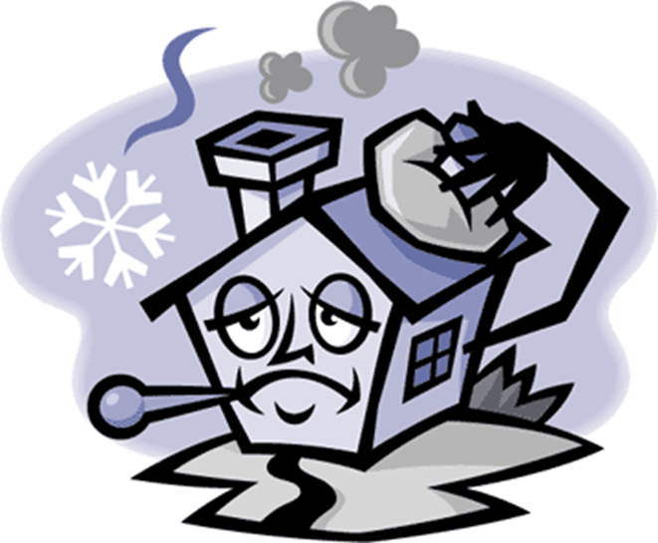
CHW’s ROLE – COMPREHENSIVE HEALTH & SAFETY CLIENT EDUCATION
Hazard RECOGNITION
clear understanding of the nature, & origin of sources of hazards or triggers
Knowledge of exposure condition & possible associated ill effects
**Both are essential for creating actions steps & hazard control plans
Addressing home & safety hazards - comprehensively
Asking questions that will address home hazards
Education protocols based on ELEMENTS OF A HEALTHY HOME

Slide 10
KEEP IT DRY
MOISTURE has a major effect on one’s health
Influence on IAQ
Creates favorable environment to bacteria, dust mites, cockroach and rodents
Excess moisture is associated with increased incidence of respiratory disease
EFFECTS of your home
Single greatest threat to a building's durability and long-term performance
Causes mold growth, which may weaken the structure
Makes the home less energy-efficient, costly to heat and cool and uncomfortable
Notes:
Again, We don’t require you to be the expert but as long as you can identify what MAY be the problem and what MAY be the cause, that is very helpful for the client
-water drips can contribute to the water bill being high and effecting their utility bill
-water leaks will contribute to moisture build up, which leads to mold and can exacerbate and trigger asthma symptoms when breathing in

Slide 11
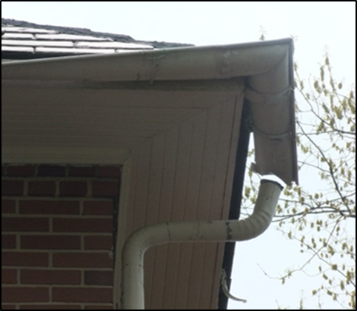
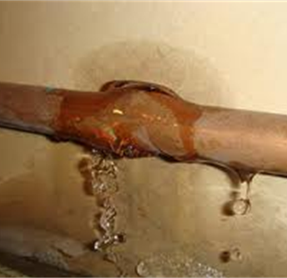
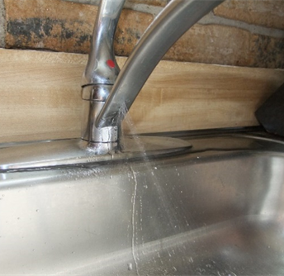
KEEP IT DRY – SOURCES OF MOISTURE
BULK WATER
Downspouts
Gutters
Plumbing leaks
Draining issues
Notes:
A primary source of moisture and water intrusion: bulk water from deficient downspouts and gutters

Slide 12
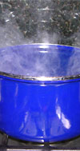
KEEP IT DRY – SOURCES OF MOISTURE
WATER VAPOR
People
Plants
Pets
Notes:
A primary source of moisture: water vapor
A 4-member family can generate 10 gallons of moisture per day

Slide 13
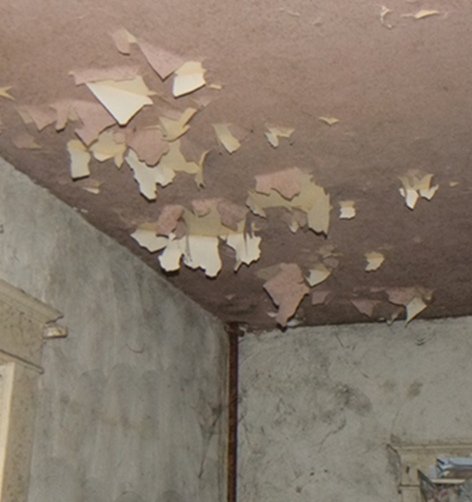
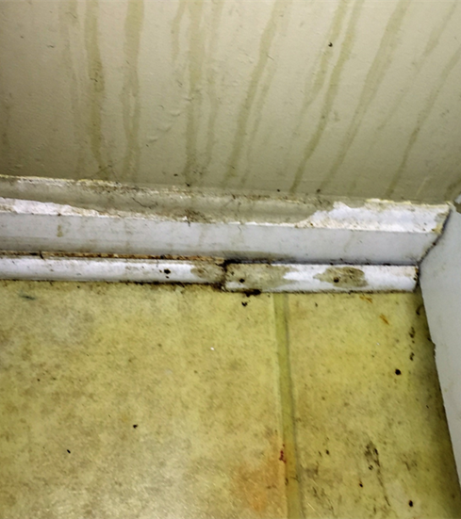
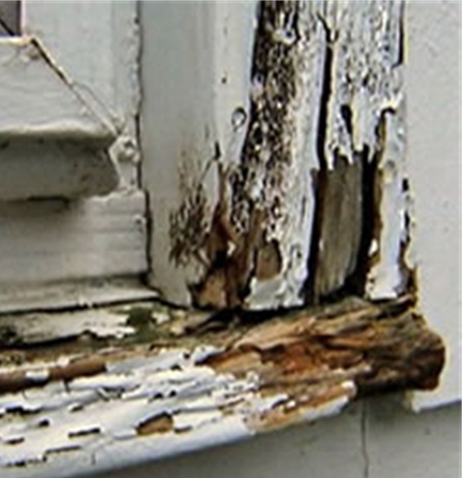
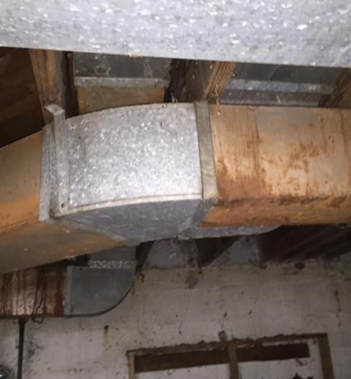
KEEP IT DRY – SIGNS OF MOISTURE

Slide 14
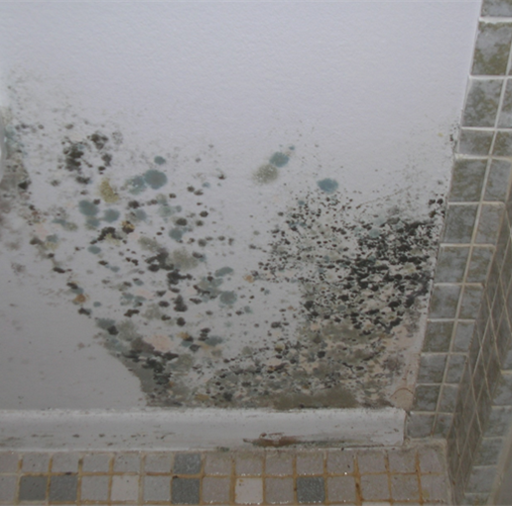
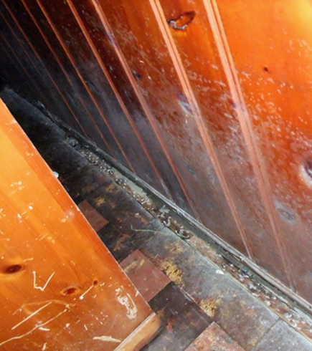
KEEP IT DRY – SYMPTOMS OF MOISTURE
MOLD
Excess moisture – cause of mold growth indoors
Needs a carbon source to grow (building materials)

Slide 15
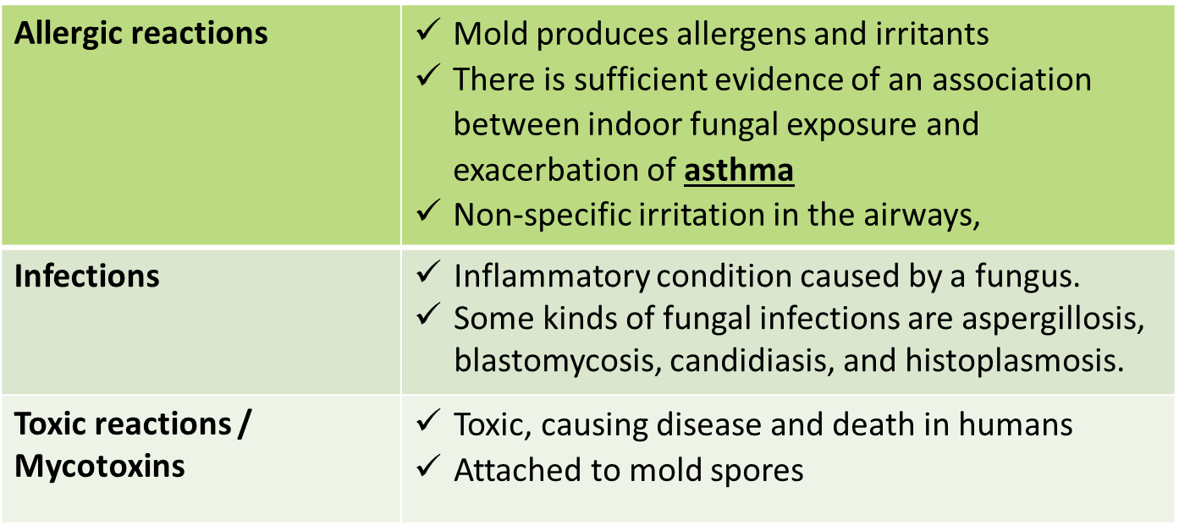
KEEP IT DRY – SYMPTOMS OF MOISTURE
MOLD
*A major health problem
Notes:
Here are some signs of mold in the house: fatigue, coughing, difficulty breathing. Elderly people are more likely to experience these signs at a much more rapid pace. This can affect their quality of life and also impact their medical bills.

Slide 16
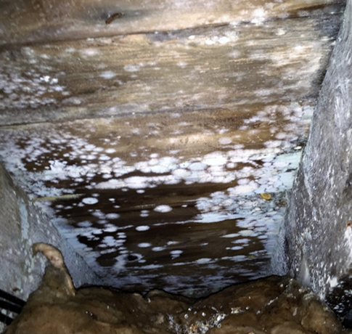
KEEP IT DRY – SYMPTOMS OF MOISTURE
Optimal growth temperature: | 68º-86º F
Relative humidity: | >70%
Growth slows down: | < 68ºF
Best factor for control is keeping RH: | < 60%
AC/dehumidifier keep the RH levels: | < 50%
Notes:
If a client had a moisture issue, they can keep track of the relative humidity levels using a hygrometer and these measures. It can be bought at a local ACE hardware or Amazon

Slide 17
KEEP IT DRY – EDUCATION
TIPS & TECHNIQUES – MOLD
- EPA Guidelines
BATHROOM TIP
- increasing ventilation (running a fan or opening a window) & cleaning more frequently will usually prevent mold from recurring/keep to a minimum
Scrub mold off hard surfaces with detergent & water
- Dry completely
Do not paint or caulk moldy surfaces
- Clean up the mold and dry the surfaces before painting - Paint applied over moldy surfaces is likely to peel
Fix plumbing leaks as soon as possible
- Dry all items completely
Absorbent or porous materials (ceiling tiles, carpet) – best option is to throw away

Slide 18
KEEP IT DRY
A dry home will:
Reduce moisture—preventing a hospitable environment for dust mite, roaches, and rodents
Prevents mold growth
Reduce potential indoor allergens & environmental triggers
Reduces potential for illnesses & household injuries
Notes:
Know resources in client’s community

Slide 19
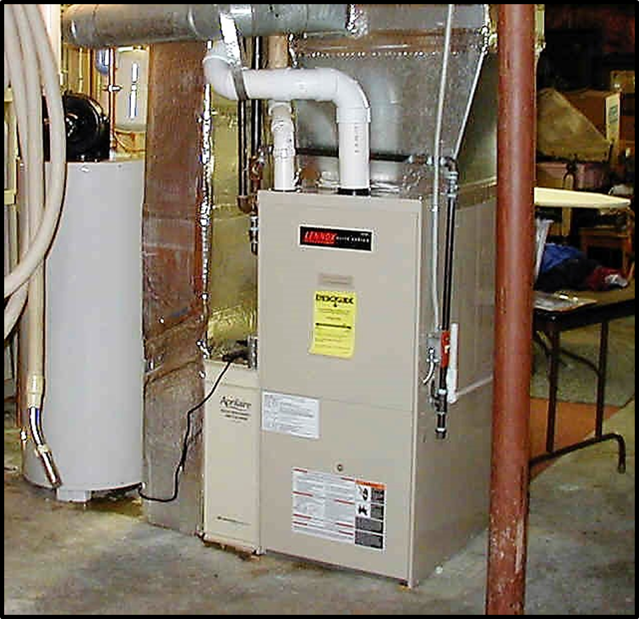
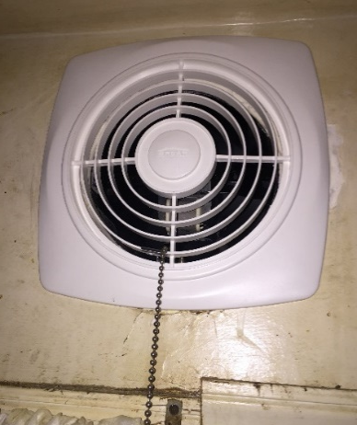
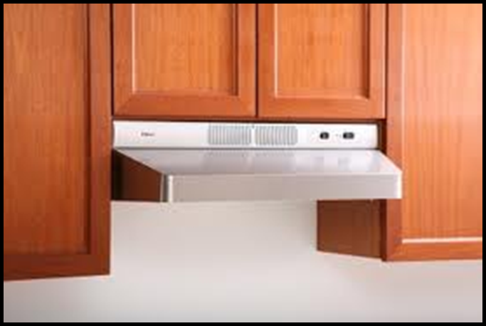
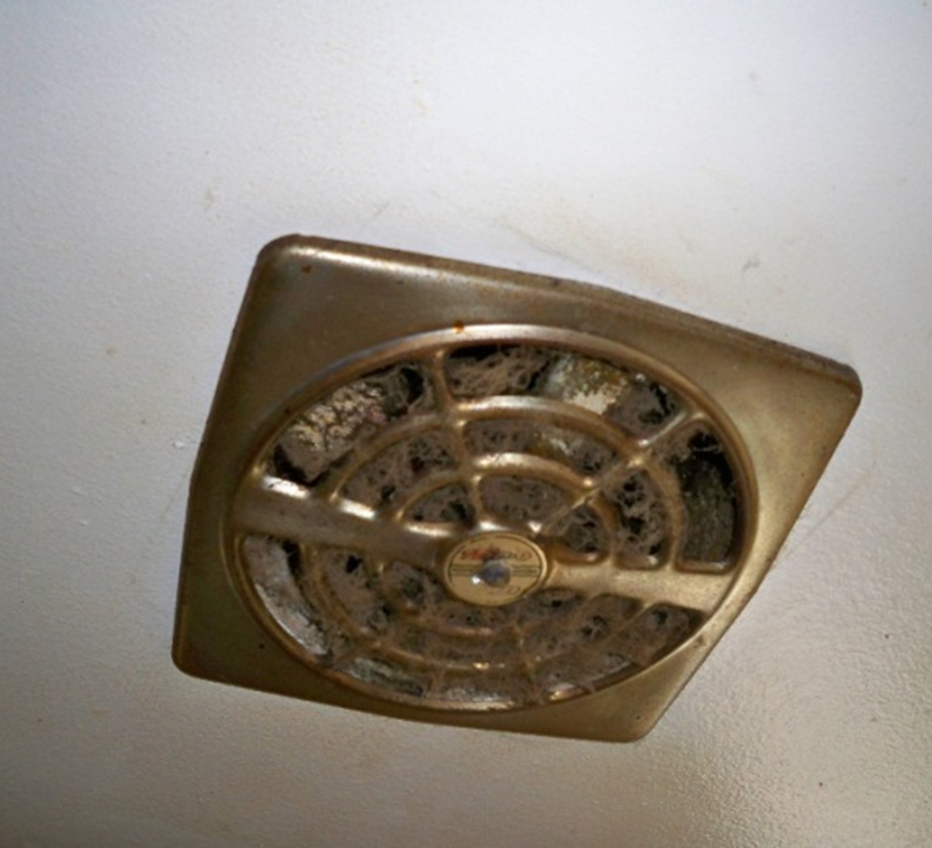
KEEP IT WELL-VENTILATED
A well-ventilated home:
Improves respiratory health
Removes moisture - reduces mold growth
Dilutes or remove contaminants - reducing their harmful effects
Free of environmental tobacco smoke
Notes:
Examples of un-ventilated health issues
Bronchitis, asthma, nosebleeds, dry and itchy skin, etc.

Slide 20
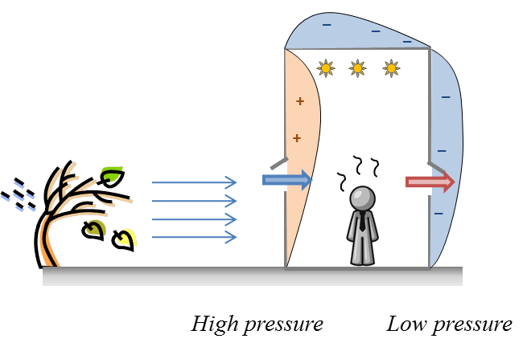
KEEP IT WELL-VENTILATED
NATURAL VENTILATION
Uncontrolled and unpredictable air movement into a building
Through cracks/small holes
Through vents: windows and doors
Traditional method
Allowing fresh outdoor air to replace indoor air

Slide 21
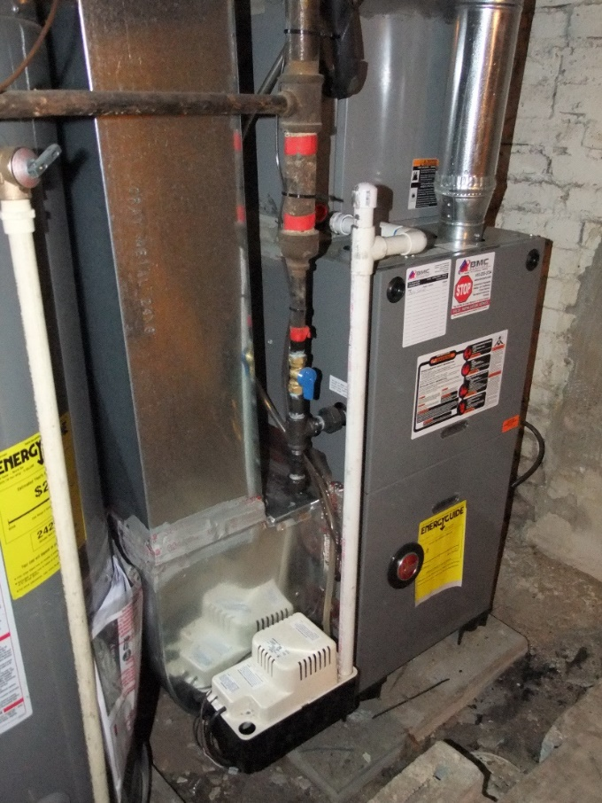
KEEP IT WELL-VENTILATED
MECHANICAL VENTILATION
Intentional
Provides controlled, uniform ventilation throughout the house
Removes pollutants, moisture, odor, VOCs, stale air
AC, Furnace, Air Purifier, etc.

Slide 22
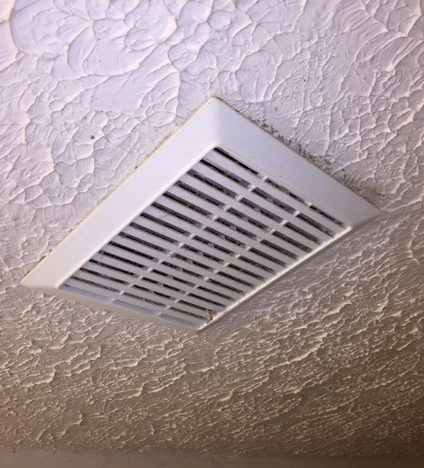
KEEP IT WELL-VENTILATED
SPOT VENTILATION
Localized exhaust fans to remove pollutants at their source
Very efficient measure for moisture management
bathroom exhaust fans, kitchen fans

Slide 23
KEEP IT WELL-VENTILATED - EDUCATION
VENTILATION – COMBUSTION CONTAMINANT CONTROL
Replacement of defective combustion appliances
Maintenance – Clean & tune combustion appliances
Install/Replace CO and Smoke alarms
Kitchen exhaust fan (to the outside)
Air filters
NATURAL VENTILATION

Slide 24
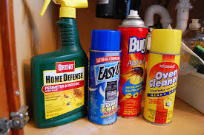
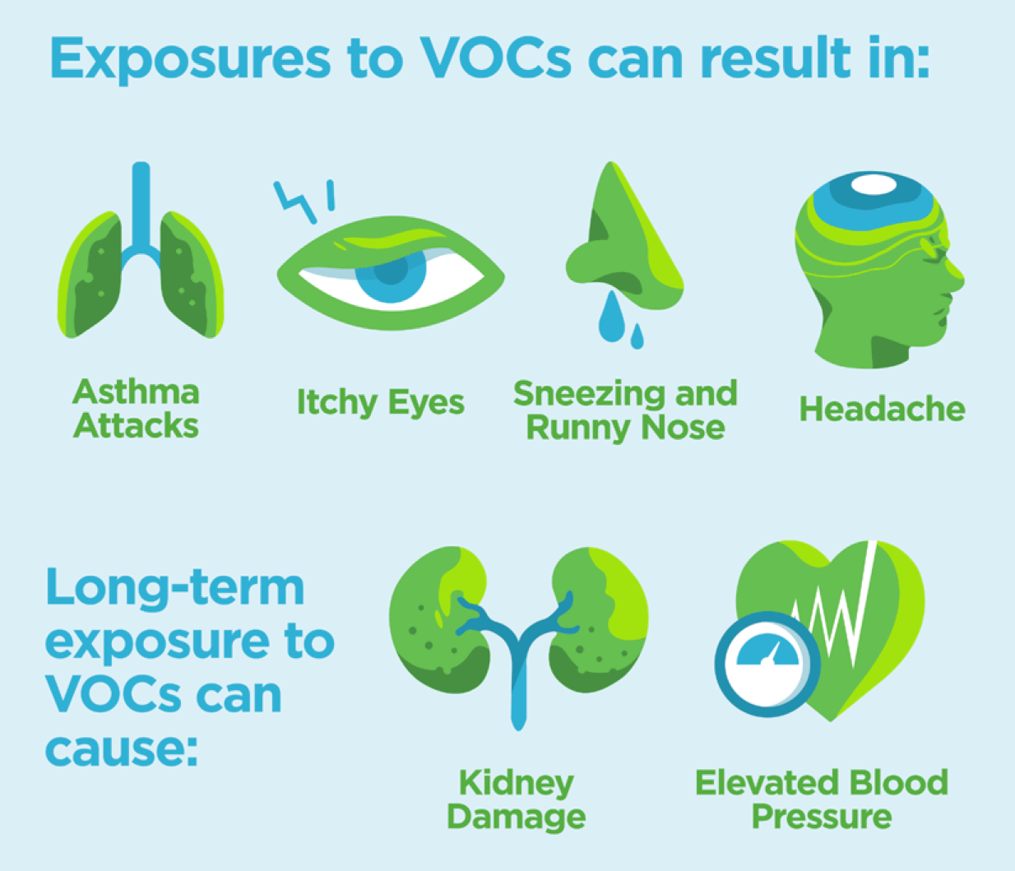
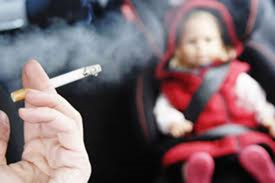
KEEP IT CONTAMINENT-FREE
VOCs
- Emitted as gases from certain solids or liquids.
- ten times higher indoors than outdoors
- cleaners, pesticides, etc.
PESTICIDES
Health effects:
Eye, nose, throat irritation
Skin rashes
ETS
Environmental Tobacco Smoke (2nd hand smoke)
Well known asthma trigger
Notes:
Environmental tobacco smoke
linked to ASTHMA & ALLERGIES
Wheezing and coughing are more common in children and people who breathe secondhand smoke
People with asthma who are around secondhand smoke have worse and frequent asthma attacks.
More than 40 percent of children who go to emergency room for asthma live with smokers

Slide 25
KEEP IT CONTAMINENT-FREE
VOCs EDUCATION
Source control
Remove unused chemicals from the home,
Use alternative products or low VOCs products
Ventilation and climate control
Increase ventilation - Increasing overall home air exchange rate
Keep temperature and relative humidity as low as possible
VOCs
- Emitted as gases from certain solids or liquids.
- ten times higher indoors than outdoors
- cleaners, pesticides, etc.
Notes:
ETS
linked to ASTHMA & ALLERGIES IN KID
Wheezing and coughing are more common in children who breathe secondhand smoke
Children with asthma who are around secondhand smoke have worse and frequent asthma attacks.
More than 40 percent of children who go to emergency room for asthma live with smokers
As of July 2020 about 3.3 million adults over the age of 65 live in the home with school age children

Slide 26
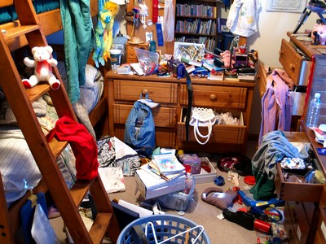
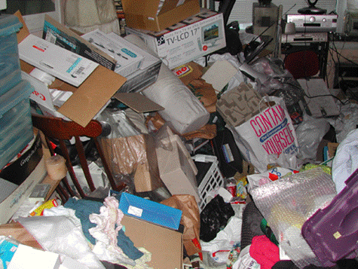
KEEP IT CLEAN
Remove shoes and/or wipe feet on a doormat before coming inside
Keep dining tables and kitchen counters free of crumbs and spills
Wash dishes and counter tops right away after eating or preparing food
Clean bathrooms and kitchens at least once every week
Cover mattresses and pillows in dust-proof zippered covers

Slide 27
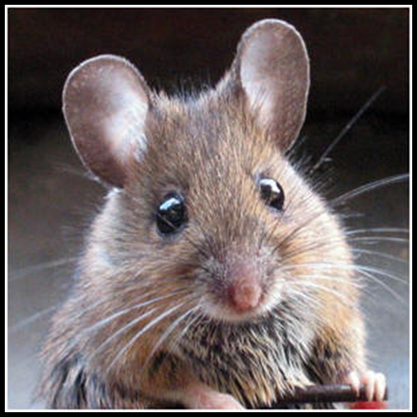
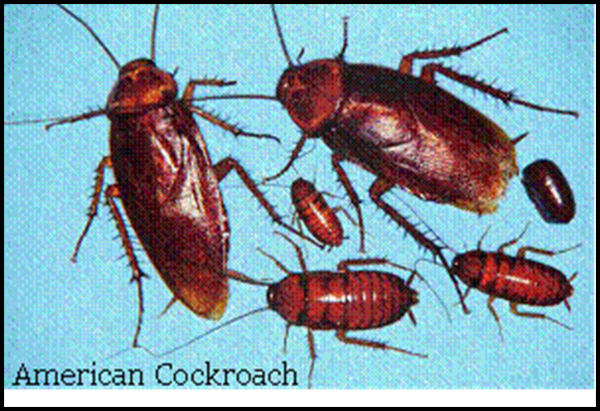
KEEP IT PEST FREE
COCKROACH DROPPINGS
- contains enough allergen to trigger many asthma attacks
(8 units allergen needed for an attack)
Each pellet can contain 500 units of the allergen: enough to trigger over 60 attacks
More cockroaches = More allergens
HOUSE MOUSE
Mainly nocturnal
Prefers seeds & grain
Nibbles when feeding, destroying food
Will gnaw on almost anything
Homes with pest and/or rodent issues are danger of many potential health hazards
This element and it’s education is in conjunction with “Keep it Clean”
Rodents can carry more than 200 human pathogens: Plague, Salmonellosis, rat bites, etc.
Notes:
Allergy to cockroaches is an important risk factor for worsening asthma. Decreasing exposure to cockroaches in the home can help reduce asthma attacks.
The outer layers of our skin become thinner as we age, which may cause an older adult to absorb more of pesticides compared to a younger person.

Slide 28
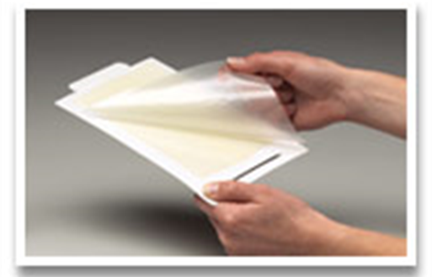
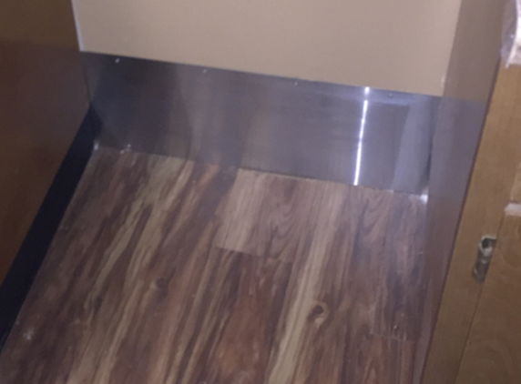
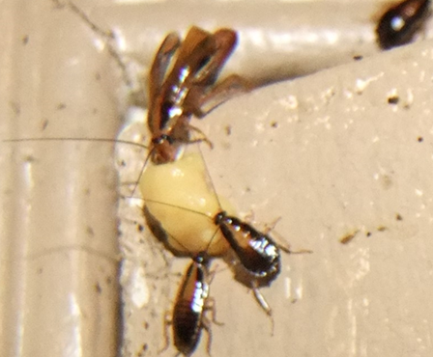
KEEP IT PEST FREE – IPM EDUCATION
INTEGRATED PEST MANAGEMENT
Keep pests out and with no place to hide
Change surrounding landscape
Block pest entries, passages, hiding places by sealing holes & cracks
Reduce food availability
Practice proper food storage & disposal
No dirty dishes in the sink overnight
Clean crumbs, grease, etc.
Knock down population
Traps
Dry Ice (Frozen CO2) – Suffocates, no residual
Insect growth regulators
Targeted pesticides ONLY when needed
Notes:
Picks:
Sticky traps
Blocked entry
IGR
Contractor’s

Slide 29
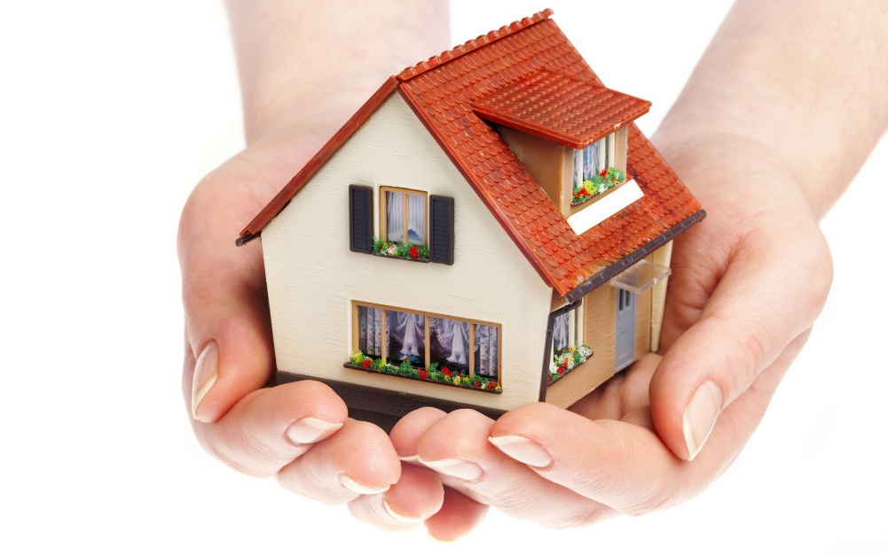
KEEP IT SAFE
Accidents in the home hurt more than 6 million people annually
The leading causes of death at home are falls, drowning, fires, poisoning, suffocation, chocking, and guns
Older adults are most at risk for having injuries at home
More than 1 million children age 5 and under are poisoned in the U.S. every year

Slide 30
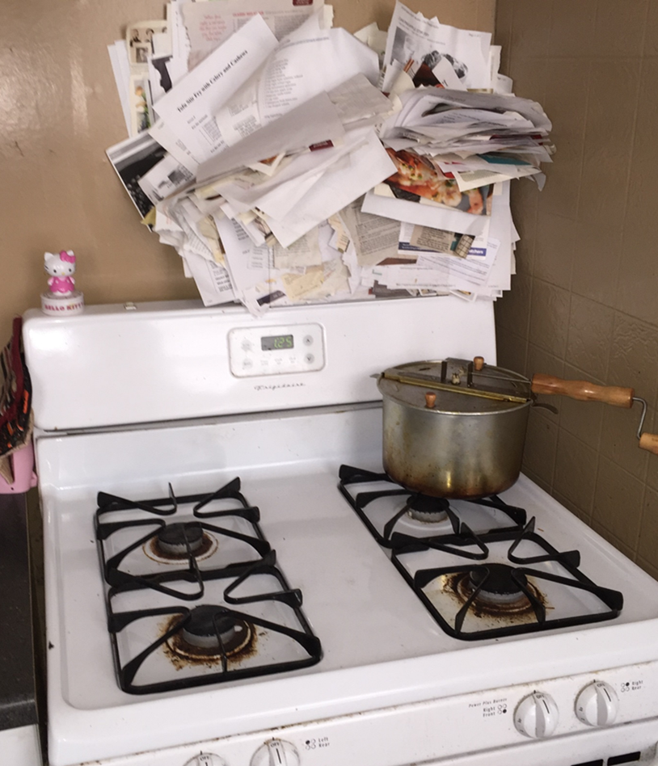
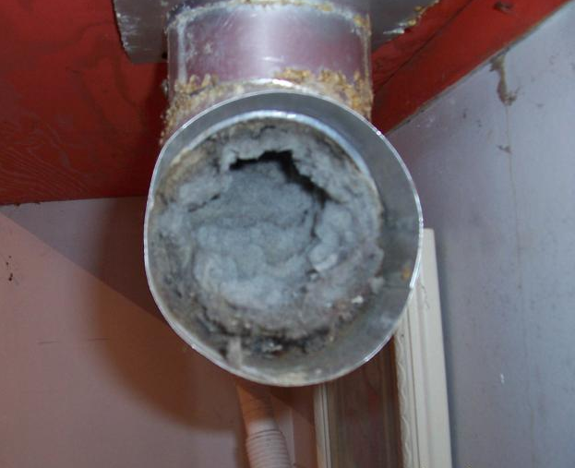
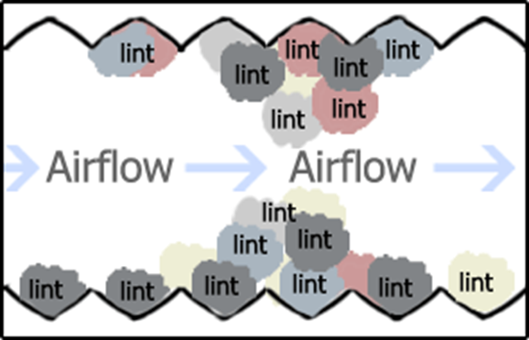
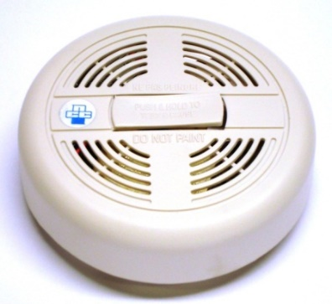
KEEP IT SAFE – FIRE SAFETY
Presence/absence of Smoke/CO detectors
Install or replace units
Fire Exits
Are fire exits available?
Are fire exits functional?
Fire escape plan?
Dryer Vents
Electrical Fires/Shock Hazards

Slide 31
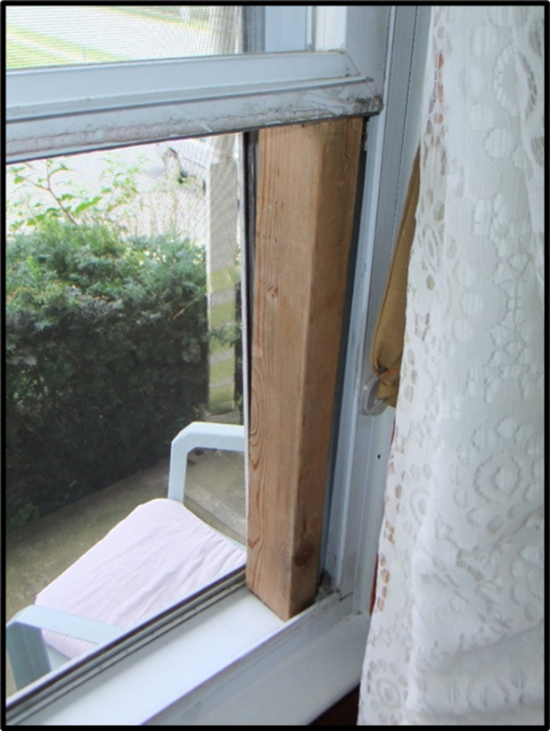
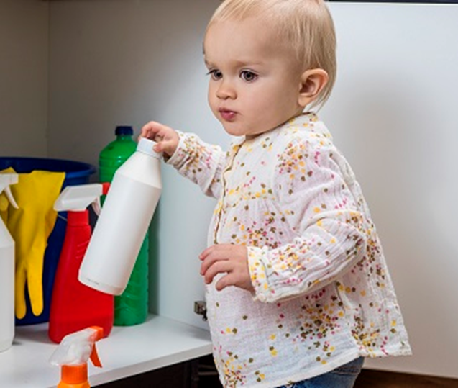
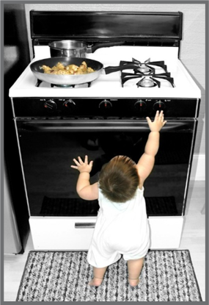
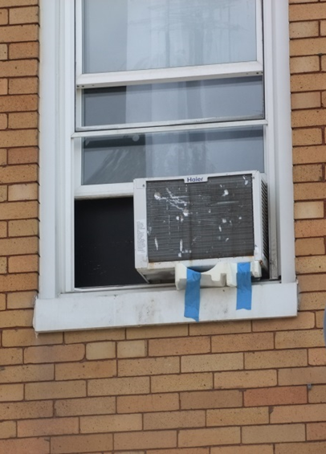
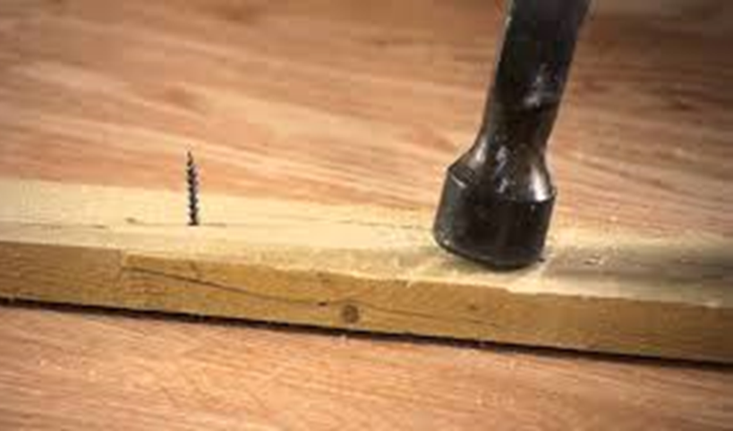
KEEP IT SAFE – CHILD + FAMILY SAFETY
Hazardous household product storage
Cabinet locks
Large appliance stability
Choking hazards
Cut/Pierce/Crush hazards
Notes:
Stability: stoves, etc.
Cut/pierce: nails, wooden frame on windows
Crush: AC unit unstable

Slide 32
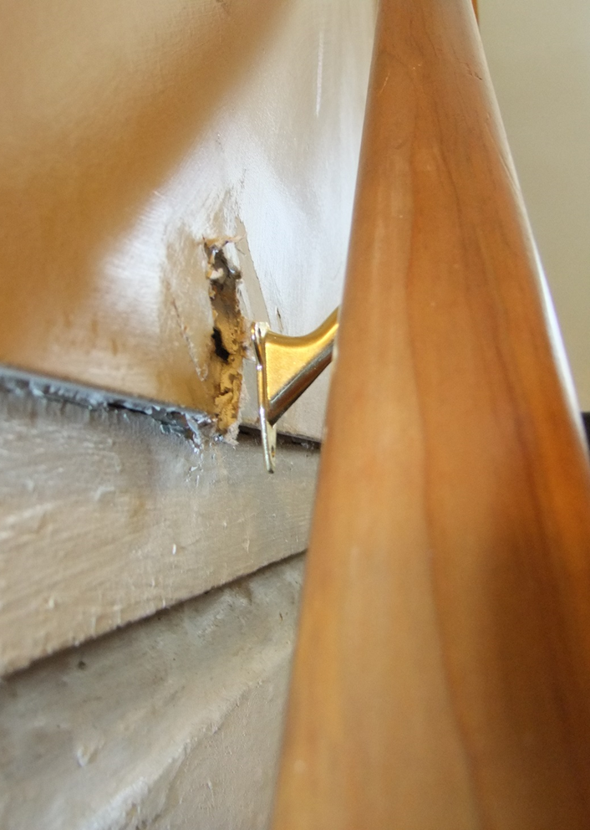
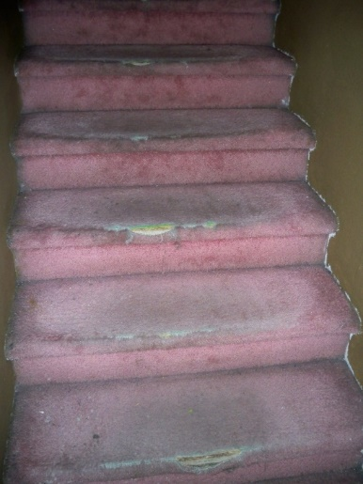
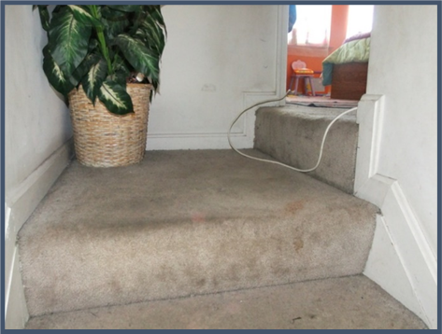
KEEP IT SAFE – SLIP + FALL SAFETY
Every second of every day, an older adult (age 65+) suffers a fall in the U.S.—making falls the leading cause of injury and injury death in this age group
60% of falls occur inside the home
- Unsafe doors or windows​
- Unsafe stairs: worn out carpet/unstable
- Missing/loose handrails​
- Smooth/slippery floors​
- Cables across the floor
Notes:
https://www.cdc.gov/homeandrecreationalsafety/falls/adultfalls.html
https://www.lively.com/health-and-aging/elderly-falls-statistics/

Slide 33
KEEP IT SAFE –EDUCATION
SAFETY GOALS
Address unsafe doors or windows
Fix holes, unsafe stairs or handrails
Smooth slippery floors
Replace worn-out areas
Remove cables across the floor

Slide 34
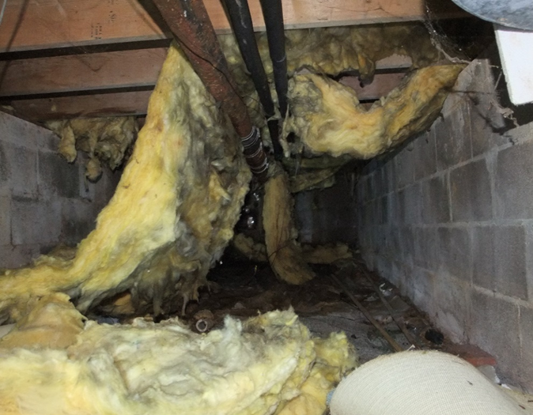
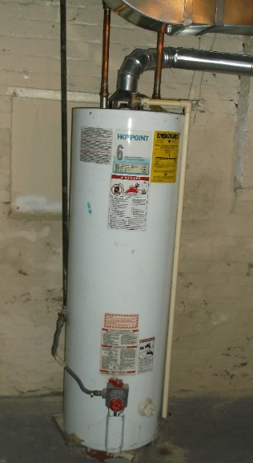
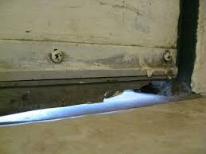
KEEP IT ENERGY EFFICIENT
Sources of energy loss
Inefficient appliances and lighting
Insufficient insulation
Uncontrolled air infiltration
Missing hot water heater tank and pipe insulation
Poor weather-stripping

Slide 35
KEEP IT WELL-MAINTAINED
Routine inspection, cleaning, and repairs can address minor repairs and problems before they become large repairs and problems
When is the last time the furnace or heating, ventilation and air conditioning (HVAC) air filters were changed?
Look for holes or gaps outside and inside that need to be filled in
Keep gutters clear
Stabilize chipping and peeling paint

Slide 36
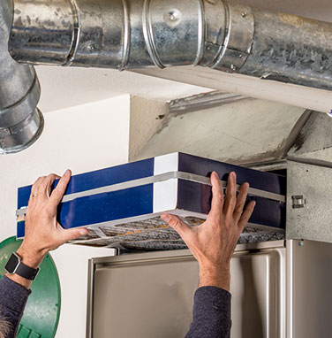
KEEP IT ENERGY EFFICIENT
GOALS
Use reduced amounts of energy, water, and resource consumption
Energy efficiency/weatherization includes:
Install proper weatherization, such as: insulation, air-sealing, weather-stripping, and window efficiency
Maintain efficient heating and cooling system; proper air flow and temperature distribution; efficient hot water / steam boiler system
What you can suggest:
Check your appliances to meet ENERGY STAR© standards
Use efficient and programmable controls for temperature, water and electricity and install Compact Fluorescent Light Bulbs (CFLs).

Slide 37
RESOURCES
Washington DC Senior Citizens Home Repair & Improvement Program
- Assistance with home repairs
- Assistance with home and yard upkeep
- Financial loans and grants to make home modifications to enable aging in place or to increase a home’s safety and weatherization - This includes HVAC, electrical, plumbing and indoor / outdoor wheelchair ramps and other accessibility improvements
Legal Counsel for the Elderly
- Championing the dignity and rights of Washington, D.C. elders by providing free legal and social work services to those in need — empowering, defending and protecting
Dept of Aging & Community Living
- In partnership with more than 20 CBO’s, they offer more than 40 free or low-cost programs to help all DC residents live boldly at any age, stage, or ability.
Dept of Aging & Community Living
Legal Counsel for Elderly
DC Senior Citizens Home Repair & Improvement Program
Notes:
Along with education and creating a care management plan, CHWs are inclined to aid in client coordination. This assists the client with access and guidance to any resources that will help in the improvement of home hazards and issues
It’s very important to stay up to date with your partnering organizations for the latest info on new services, grants, and opportunities to provide access to helpful healthy housing servicesf3dv

Slide 38
Thank You!
Questions?
Alexia Jones
ajones@ghhi.org
www.ghhi.org @HealthyHousing GHHInational

